Slide 1
NLP Tasks and Language Representations
Heng Ji
hengji@illinois.edu

Slide 2
Project Sign-Up [Discussions on Sept 8]
https://docs.google.com/spreadsheets/d/1oenpLR00gVjj-zIkCCWu6c1M3-04I9RQ/edit?usp=sharing&ouid=116268516934325149275&rtpof=true&sd=true

Slide 3
The Steps in NLP
**we can go up, down and up and
down and combine steps too!!
**every step is equally complex

Slide 4
Major Topics
Words
Syntax
Meaning
Discourse
5. Applications exploiting each

Slide 5
Simple Applications
Word counters (wc in UNIX)
Spell Checkers, grammar checkers
Predictive Text on mobile handsets

Slide 6
Bigger Applications
Intelligent computer systems
NLU interfaces to databases
Computer aided instruction
Information retrieval
Intelligent Web searching
Data mining
Machine translation
Speech recognition
Natural language generation
Question answering
Image Caption Generation

Slide 7
Part-of-Speech Tagging and Syntactic Parsing
S
NP
VP
NN
IN
NP
VBZ
NP
School
of
NP
CC
NP
presents
JJ
NN
NN
and
NN
Wonderful
Town
Theatre
Dance

Slide 8
Semantic Role Labeling: Adding Semantics into Trees
S
NP/ARG0
VP
DT
JJ
NN
VBD
NP/ARG2
NP/ARG1
The
Supreme
Court
gave
NNS
VBG
NN
states
working
Leeway/ARG0
Predicate
Predicate

Slide 9
Core Arguments
Arg0 = agent
Arg1 = direct object / theme / patient
Arg2 = indirect object / benefactive / instrument / attribute / end state
Arg3 = start point / benefactive / instrument / attribute
Arg4 = end point

Slide 10
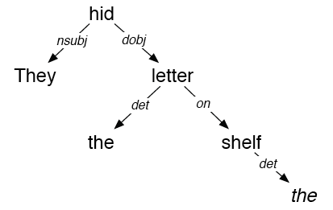
Dependency Parsing
They hid the letter on the shelf

Slide 11
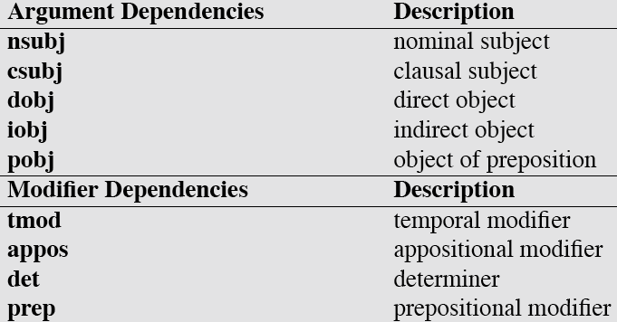
Dependency Relations

Slide 12
Name Tagging
Since its inception in 2001, <name ID=“1” type=“organization”>Red</name>has caused a stir in
<name ID=“2” type=“location”>Northeast Ohio</name> by stretching the boundaries of classical by adding multi-media elements to performances and looking beyond the expected canon of composers.
Under the baton of <name ID=“3” type=“organization”> Red</name> Artistic Director <name ID=“4” type=“person”>Jonathan Sheffer</name>, <name ID=“5” type=“organization”>Red</name> makes its debut appearance at <name ID=“6” type=“organization”> Kent State University</name> on March 7 at 7:30 p.m.

Slide 13
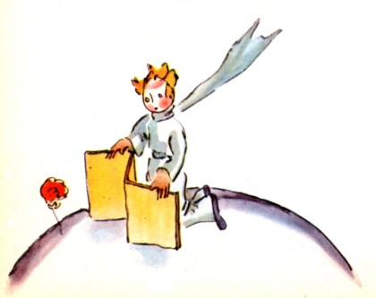
Coreference Resolution
But the little prince could not restrain admiration:
"Oh! How beautiful you are!"
"Am I not?" the flower responded, sweetly. "And I was born at the same moment as the sun . . ."
The little prince could guess easily enough that she was not any too modest--but how moving--and exciting--she was!
"I think it is time for breakfast," she added an instant later. "If you would have the kindness to think of my needs--"
And the little prince, completely abashed, went to look for a sprinkling-can of fresh water. So, he tended the flower.

Slide 14
Relation Extraction
relation: a semantic relationship between two entities
ACE relation type example
Agent-Artifact Rubin Military Design, the makers of the Kursk
Discourse each of whom
Employment/ Membership Mr. Smith, a senior programmer at Microsoft
Place-Affiliation Salzburg Red Cross officials
Person-Social relatives of the dead
Physical a town some 50 miles south of Salzburg
Other-Affiliation Republican senators

Slide 15
Temporal Information Extraction
In 1975, after being fired from Columbia amid allegations that he used company funds to pay for his son's bar mitzvah, Davis founded Arista
Is ‘1975’ related to the employee_of relation between Davis and Arista?
If so, does it indicate START, END, HOLDS… ?
Each classification instance represents a temporal expression in the context of the entity and slot value.
We consider the following classes
START Rob joined Microsoft in 1999.
END Rob left Microsoft in 1999.
HOLDS In 1999 Rob was still working for Microsoft.
RANGE Rob has worked for Microsoft for the last ten years.
NONE Last Sunday Rob’s friend joined Microsoft.
15

Slide 16
Event Extraction
An event is specific occurrence that implies a change of states
event trigger: the main word which most clearly expresses an event occurrence
event arguments: the mentions that are involved in an event (participants)
event mention: a phrase or sentence within which an event is described, including trigger and arguments
ACE defined 8 types of events, with 33 subtypes
ACE event type/subtype Event Mention Example
Life/Die Kurt Schork died in Sierra Leone yesterday
Transaction/Transfer GM sold the company in Nov 1998 to LLC
Movement/Transport Homeless people have been moved to schools
Business/Start-Org Schweitzer founded a hospital in 1913
Conflict/Attack the attack on Gaza killed 13
Contact/Meet Arafat’s cabinet met for 4 hours
Personnel/Start-Position She later recruited the nursing student
Justice/Arrest Faison was wrongly arrested on suspicion of murder
Argument, role=victim
trigger

Slide 17
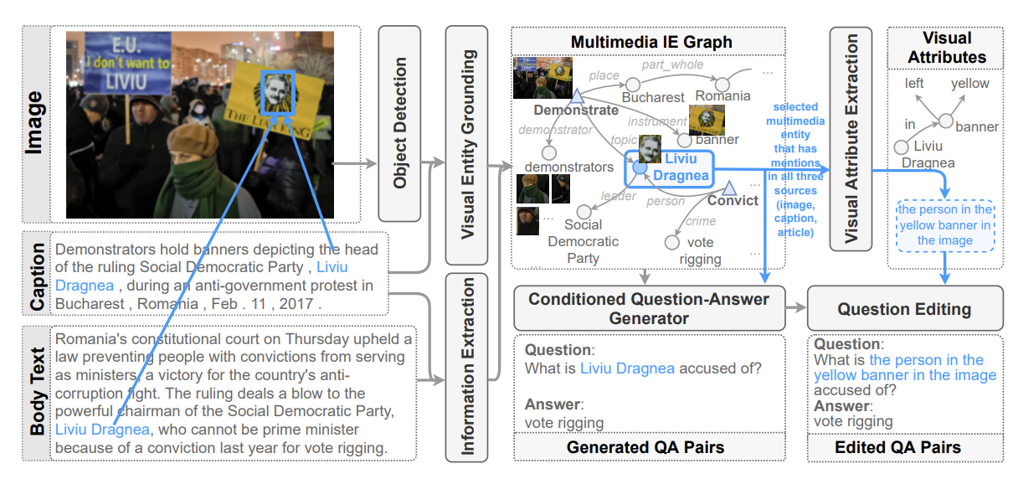
Question Answering
[Reddy et al., 2022]

Slide 18
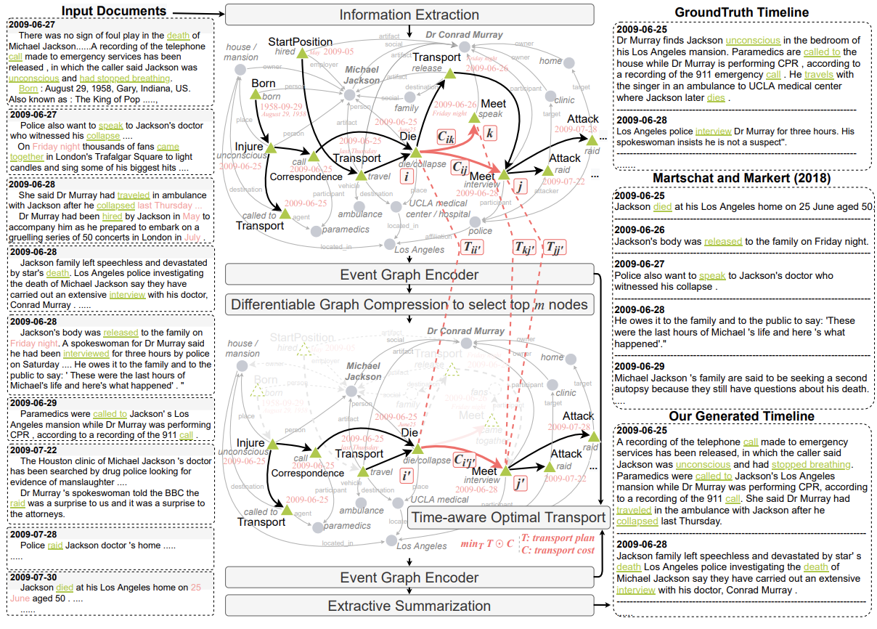
Summarization
[Li et al., 2021]

Slide 19
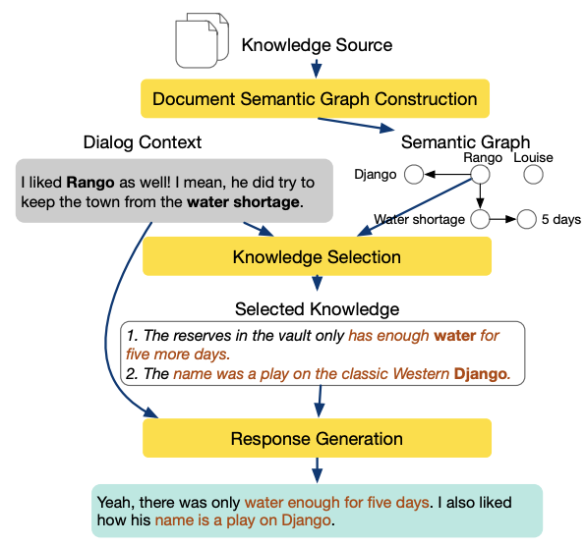
Dialog Systems
[Li et al., 2022]

Slide 20
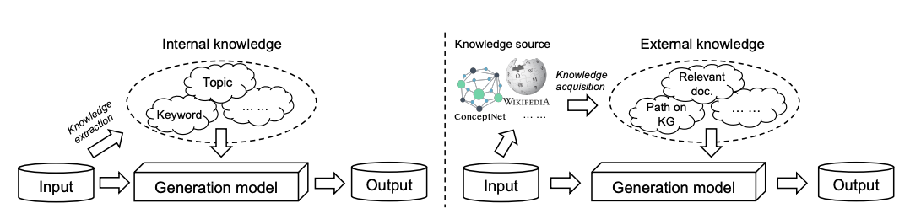
Conditioned Generation
[Yu et al., 2022]

Slide 21
Machine Translation

Slide 22
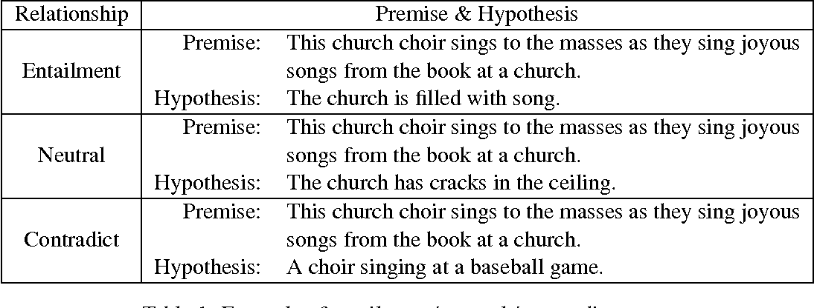
Textual Entailment / Natural Language Inference

Slide 23
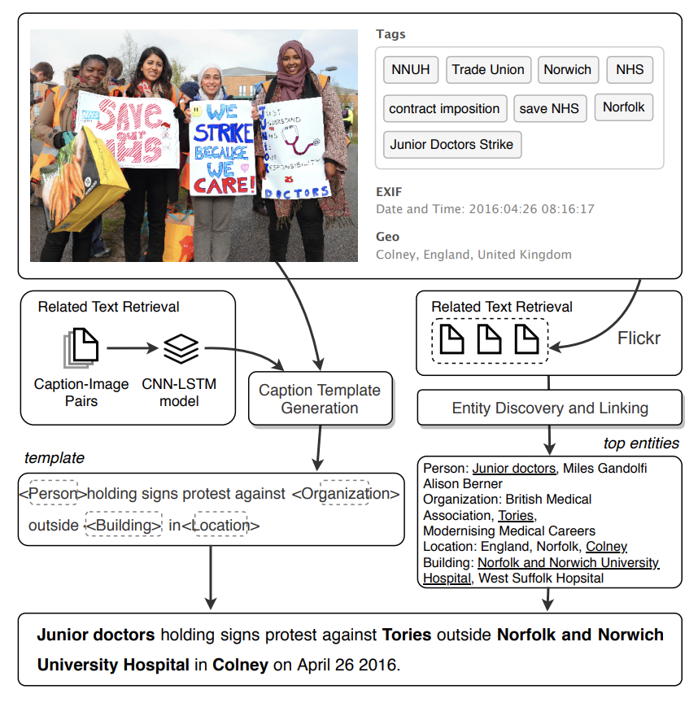
Image/Video Caption Generation
[Lu et al., 2018]

Slide 24
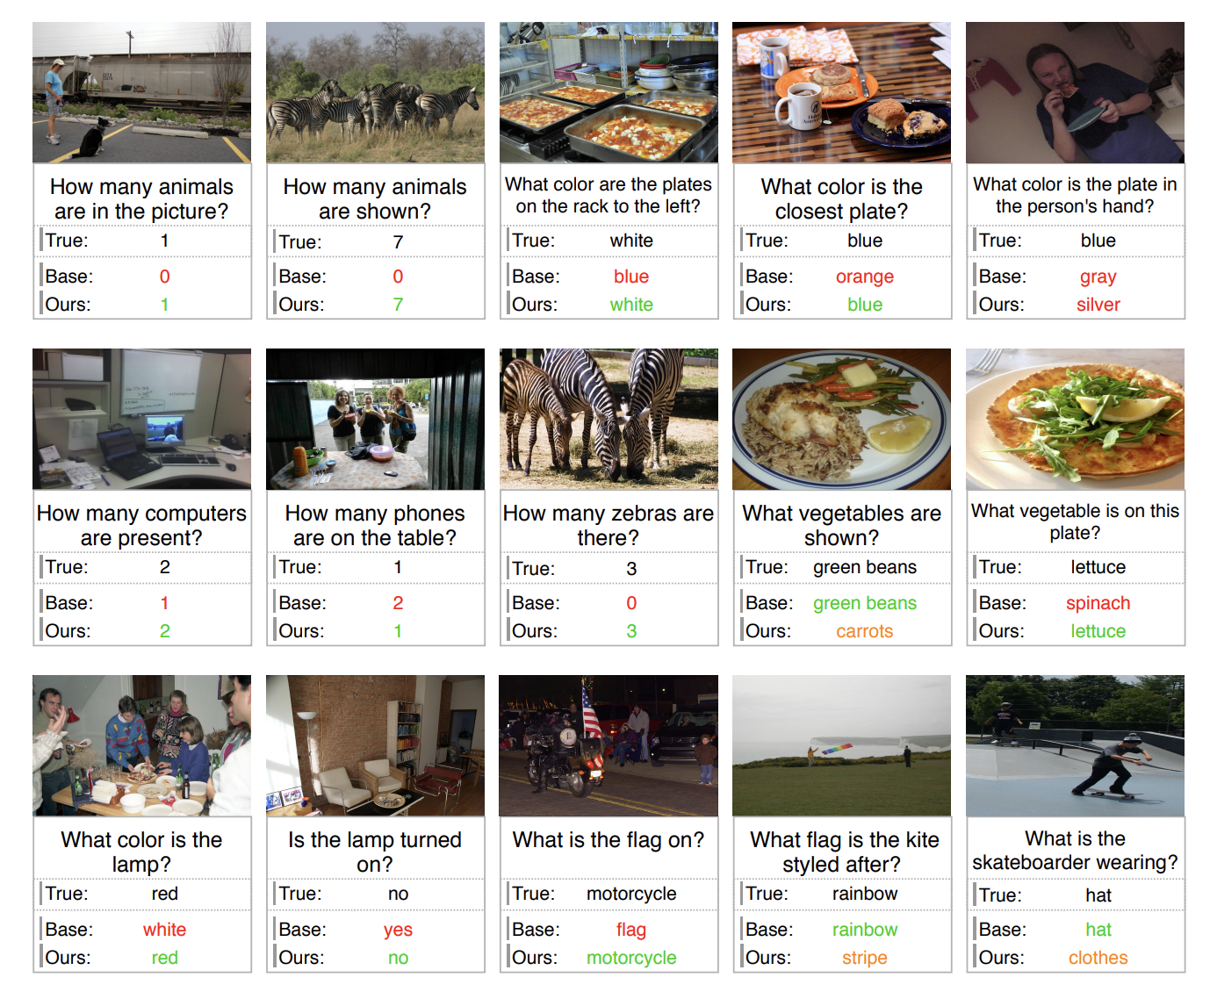
Visual Question Answering
[Whitehead et al., 2021]

Slide 25
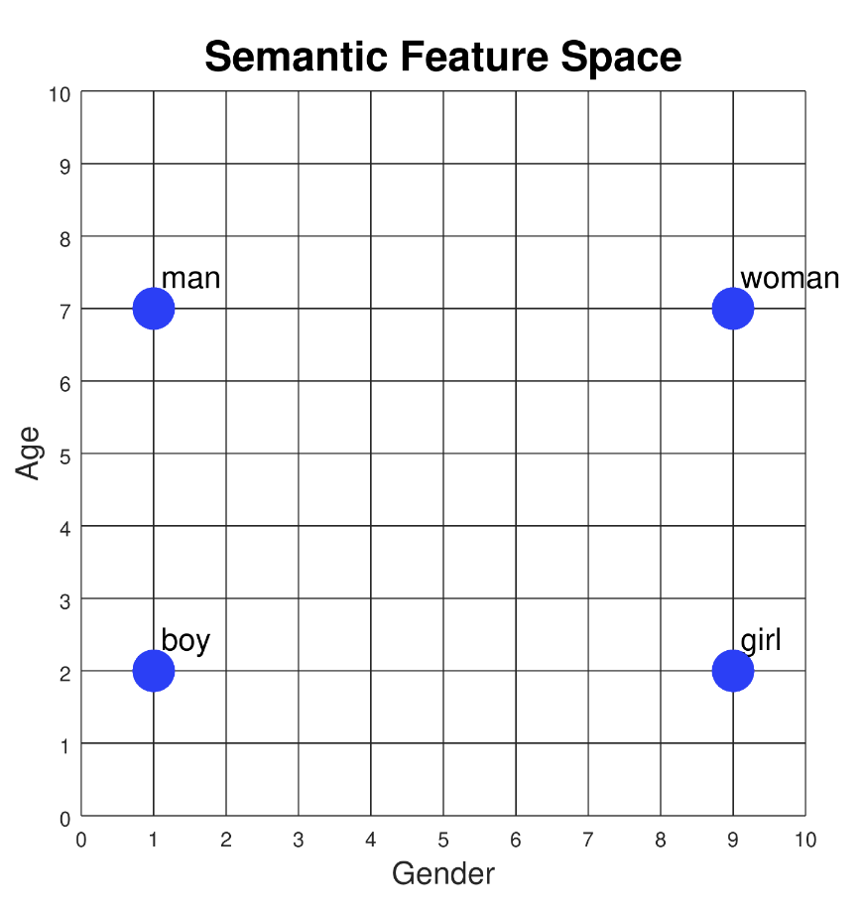
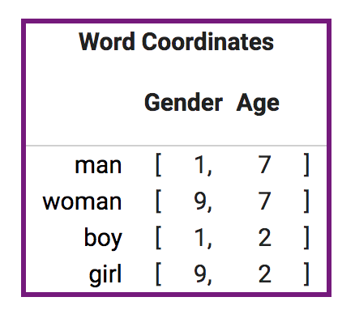
Quiz 1: Assign Coordinates to each word

Slide 26
Quiz 2: How to Represent Adult, Child, Infant, Grandfather?

Slide 27
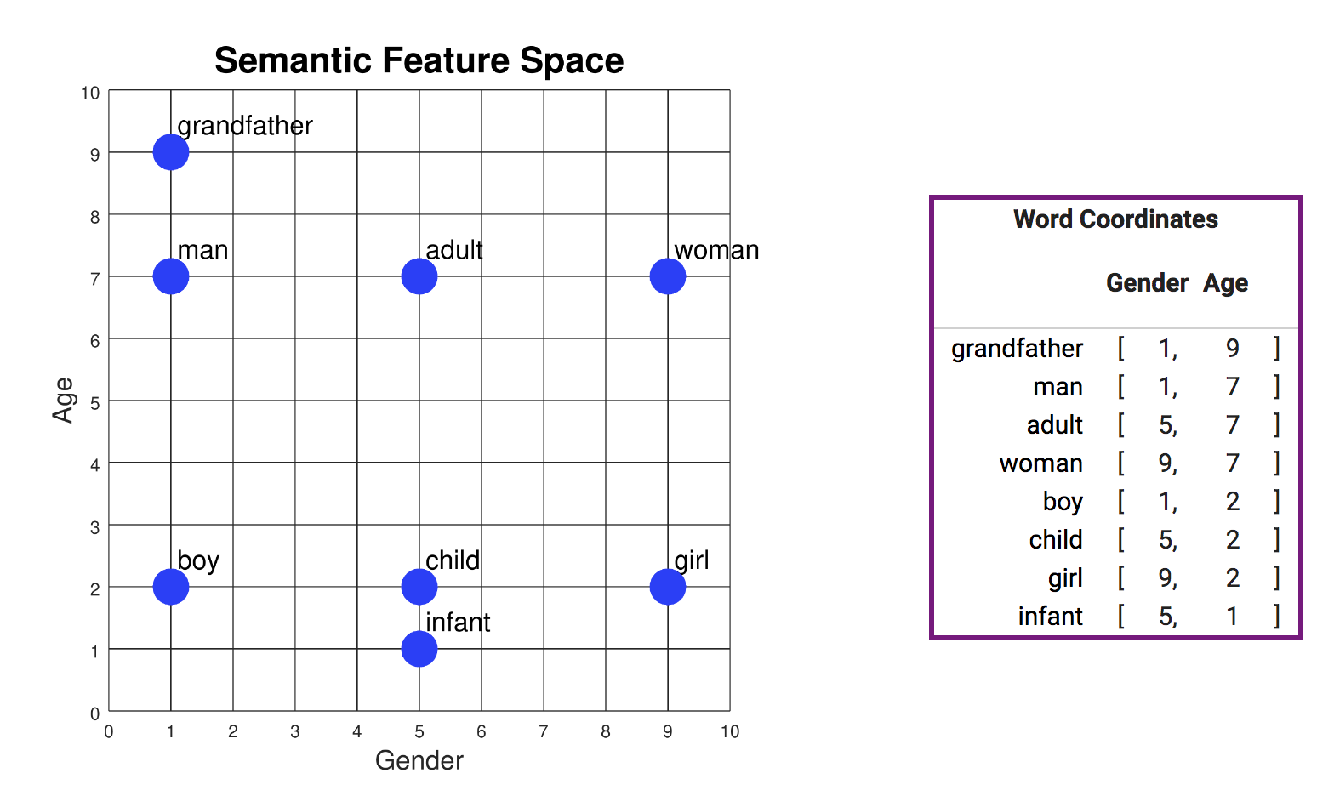
Quiz 3: How to Represent King, Queen, Prince and Princess?

Slide 28
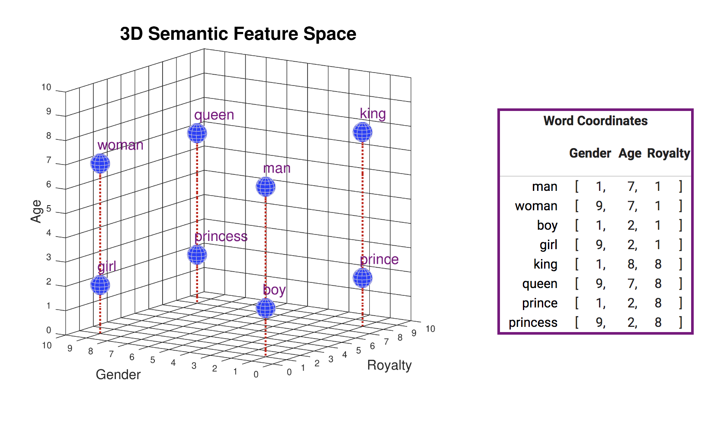
Quiz 3: How to Represent King-Man, King-Man+Woman?

Slide 29
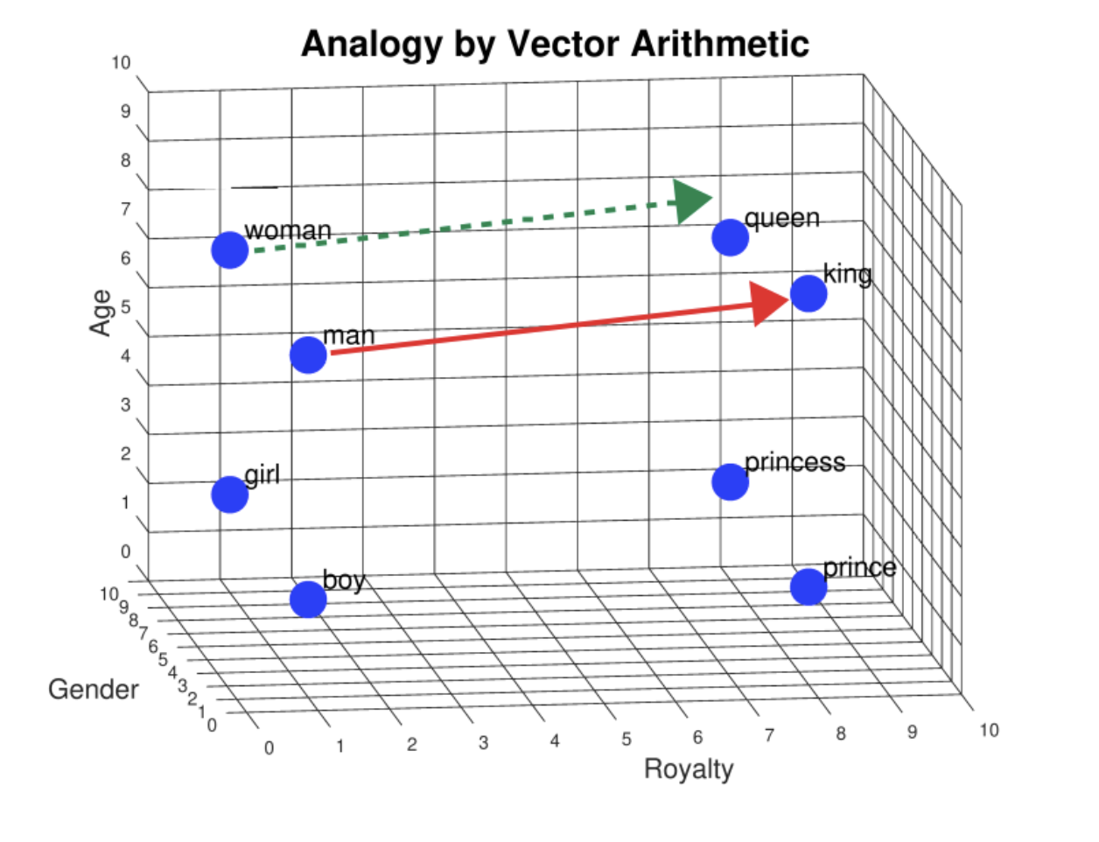
Word meaning is not discrete: Let’s use vectors to represent semantics
Quiz 4: How to Represent Cucumber, Smiled, Honesty, Rescue?

Slide 30
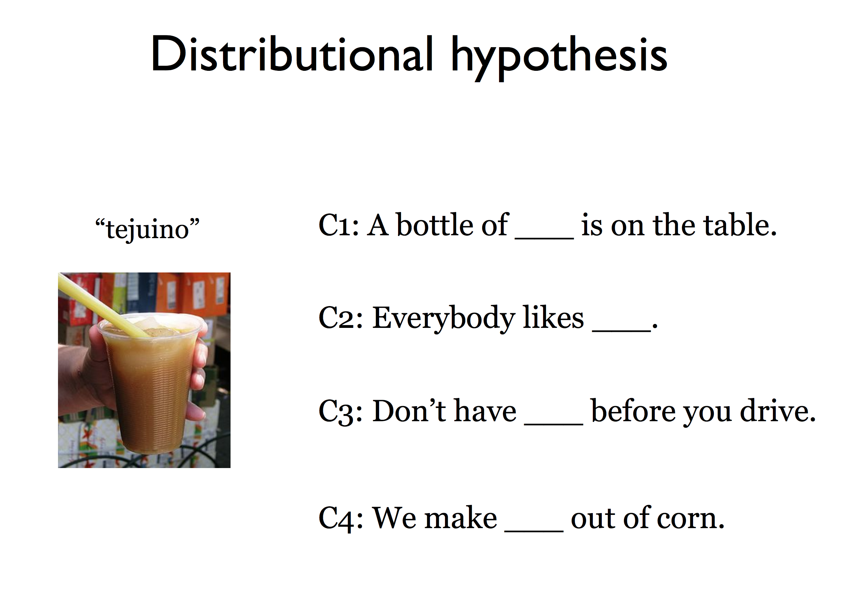
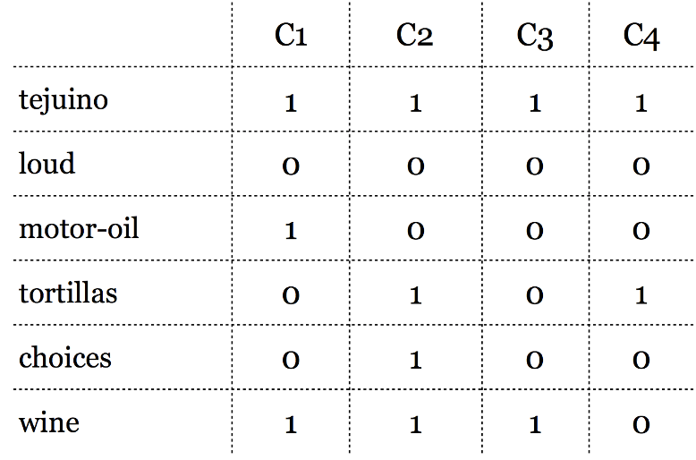
[Firth 1957]: words that occur in similar contexts tend to have similar meanings

Slide 31
Intuition: why vectors?
Consider sentiment analysis:
With words, a feature is a word identity
Feature 5: 'The previous word was "terrible”’
Requires exact same word to be in training and test
With embeddings:
Feature is a word vector
The previous word was vector [35,22,17…]
Now in the test set we might see a similar vector [34,21,14]
We can generalize to similar but unseen words!!!

Slide 32

Deep Neural Networks: Inspired from Our Brain Structure
By BruceBlaus - Own work, CC BY 3.0, https://commons.wikimedia.org/w/index.php?curid=28761830
Notes:
Neural networks are called neural because their origins lie in the McCulloch-Pitts neuron, which was a 1943 simplified model of the human neuron as a kind of computing element that could be described in terms of propositional logic. But the modern use in language processing no longer draws on these early biological inspirations and the name neural is really just a kind of historical remnant.

Slide 33
Neural Network Unit This is not in your brain
Take weighted sum of inputs, plus a bias
Instead of just using z, we'll apply a nonlinear activation function f:
Output value
Non-linear transform
Weighted sum
bias
Weights
Input layer
Notes:
Instead, a modern neural network is a network of small computing units, each of which takes a vector of input values and produces a single output value.
Over the next few lectures we'll introduce these units and see how they connect together into feedforward networks, so called because the computation proceeds iteratively from one layer of units to the next. The use of modern neural nets is often called deep learning, because modern networks are often deep (have many layers).
The building block of a neural network is a single computational unit. A unit takes a set of real valued numbers as input, performs some computation on them (combining with weights and biases and a non-linear transform), and produces an output. Let's see this in more detail.

Slide 34
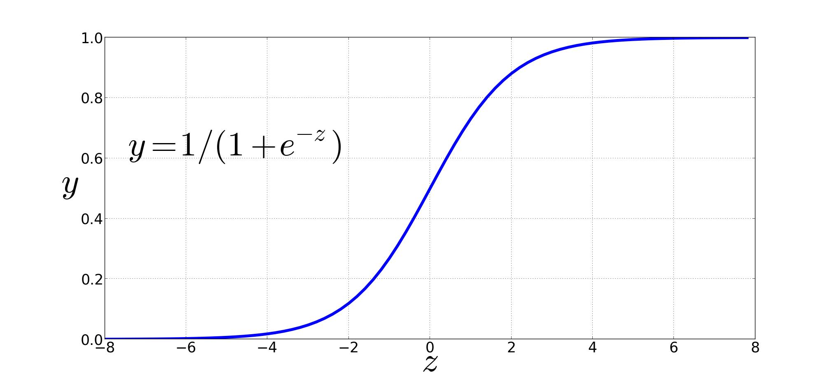
Non-Linear Activation Functions for Better Generalization/Normalization
Sigmoid
Final function the unit is computing:
Notes:
We're already seen the sigmoid for logistic regression: 1 over 1 plus exp (-z).
The sigmoid has a number of advantages; it maps the output into the range [0,1], which is useful in squashing outliers toward 0 or 1. And it’s differentiable, which as we saw is handy for learning

Slide 35
Neural Network
Multiple sets of weights in sequence
Multiple hidden layers
x^{n} = Φ(Wx^{n-1} + b)
W is weight matrix
b is bias vector
x^{n-1} is response from previous layer
Notes:
So, how does SGNS work?
Let’s say we have this sentence,
(This example was shamelessly taken from Marco Baroni)

Slide 36


Where did LM and DNN meet? Recurrent Neural Network (RNN)
Neural network with loops (output of previous step is input of next)
Maintains hidden state
Tracks previous inputs
Handle variable length input (sentences, video frames,...)
Single differentiable function from input words to output probabilities
h_{t} = f_{W}(h_{t-1}, x_{t})
h_{t} = tanh(W_{h}h_{t-1} + W_{x}x_{t})
y_{t} = W_{y}h_{t}
http://colah.github.io/posts/2015-08-Understanding-LSTMs/
Notes:
So, how does SGNS work?
Let’s say we have this sentence,
(This example was shamelessly taken from Marco Baroni)

Slide 37
Language Modeling with RNN
Input is one-hot encoding of words
Multiply by embedding matrix
Output predicts probability distribution over vocabulary: P(next word|previous words)
Notes:
So, how does SGNS work?
Let’s say we have this sentence,
(This example was shamelessly taken from Marco Baroni)

Slide 38
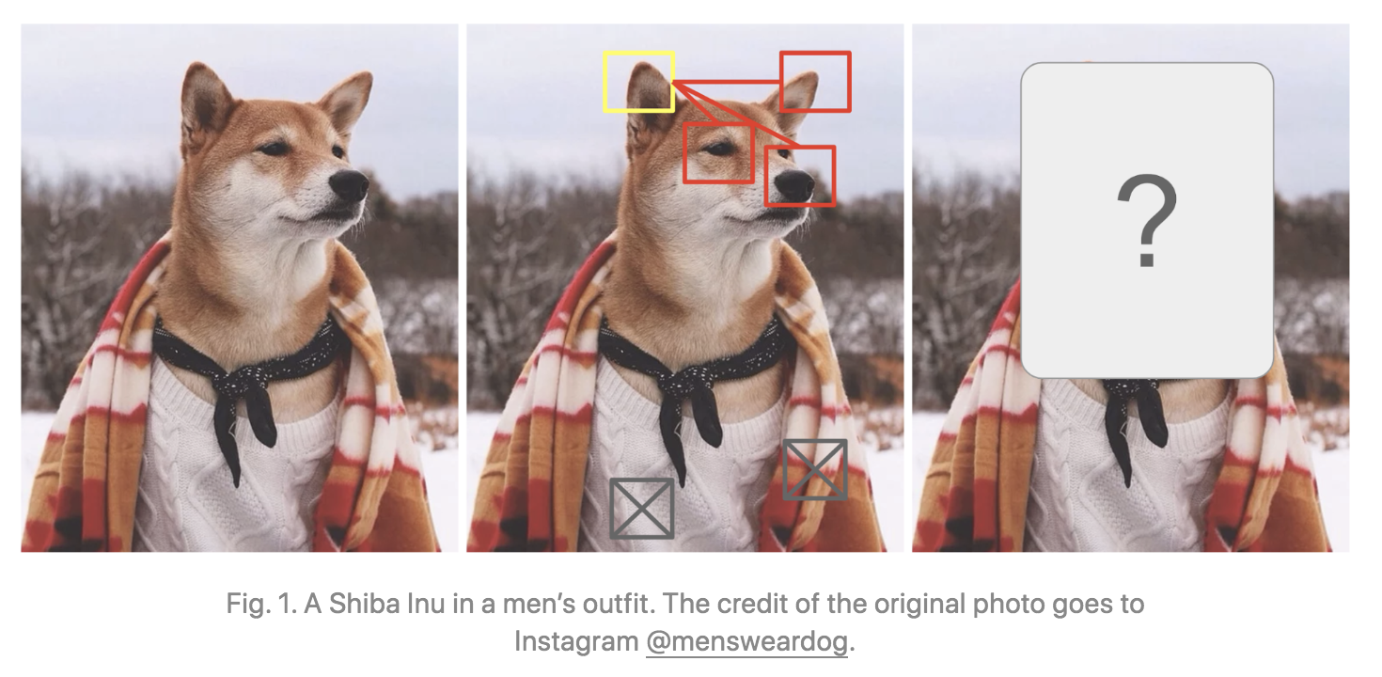
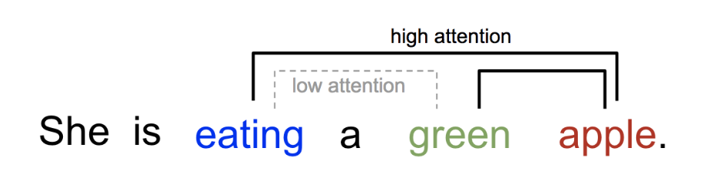
But not all contextual words are equally important: Self-Attention
She poured water from the pitcher to the cup until it was full.
What does “it” refer to? And why?
She poured water from the pitcher to the cup until it was empty.
What does “it” refer to? And why?
The key is to be selective and determine which words are most important in a specific context.
38
Notes:
Change low resource IL to a language which is not in wikipedia
Word-level: from bi-lingual dicts and alignment; structure-level comes from wals; multi-level alignment

Slide 39
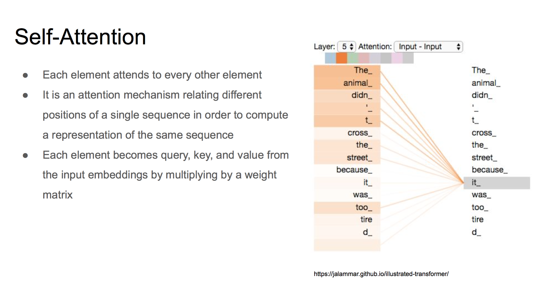
39
Notes:
Change low resource IL to a language which is not in wikipedia
Word-level: from bi-lingual dicts and alignment; structure-level comes from wals; multi-level alignment

Slide 40
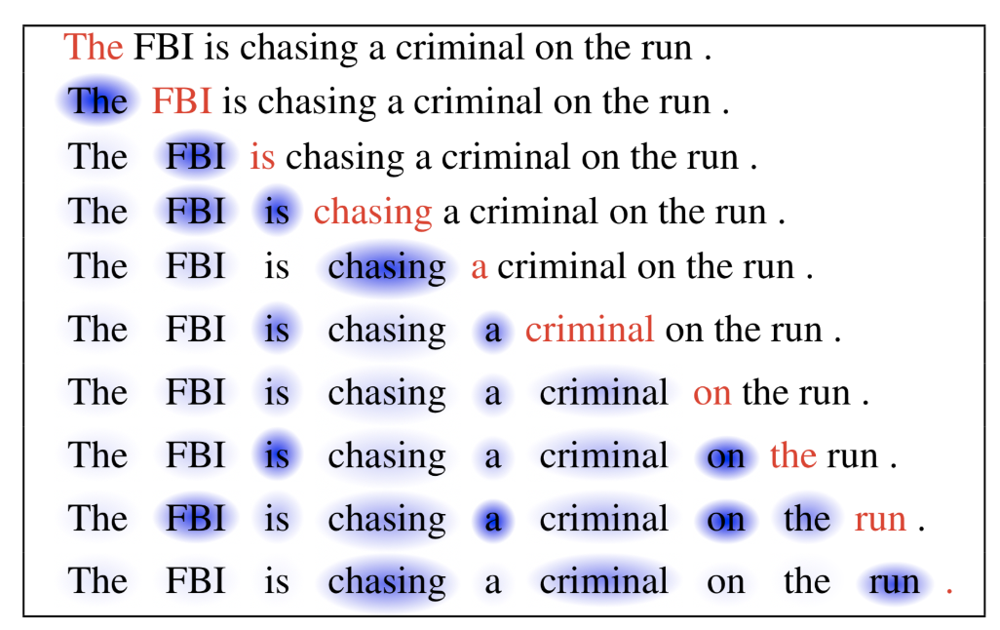
Self-Attention for Generation
40
Notes:
Change low resource IL to a language which is not in wikipedia
Word-level: from bi-lingual dicts and alignment; structure-level comes from wals; multi-level alignment

Slide 41
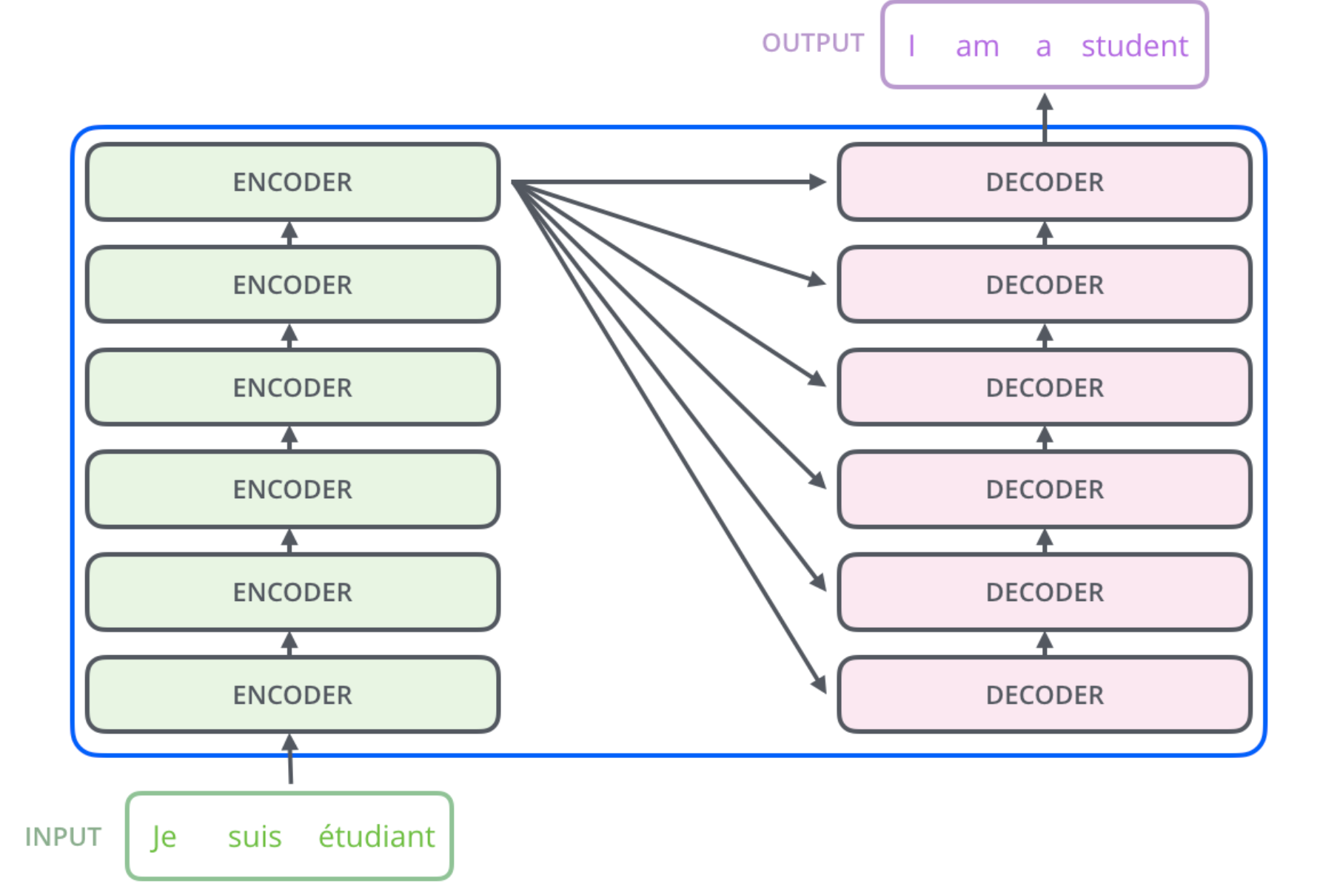
Transformer: High-level architecture

Slide 42
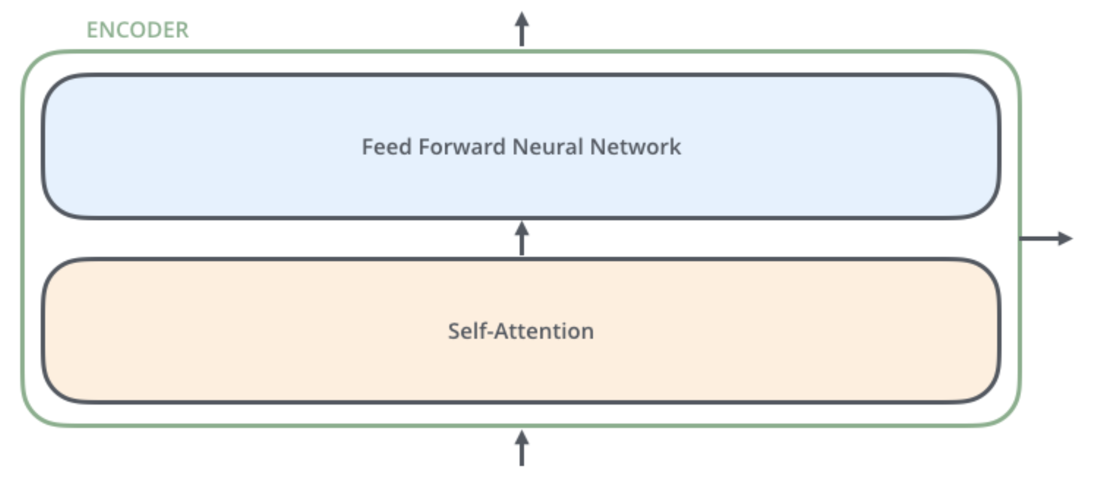
The encoders are all identical in structure (yet they do not share weights). Each one is broken down into two sub-layers
outputs of the self-attention are fed to a feed-forward neural network. The exact same one is independently applied to each position.
helps the encoder look at other words in the input sentence as it encodes a specific word.

Slide 43
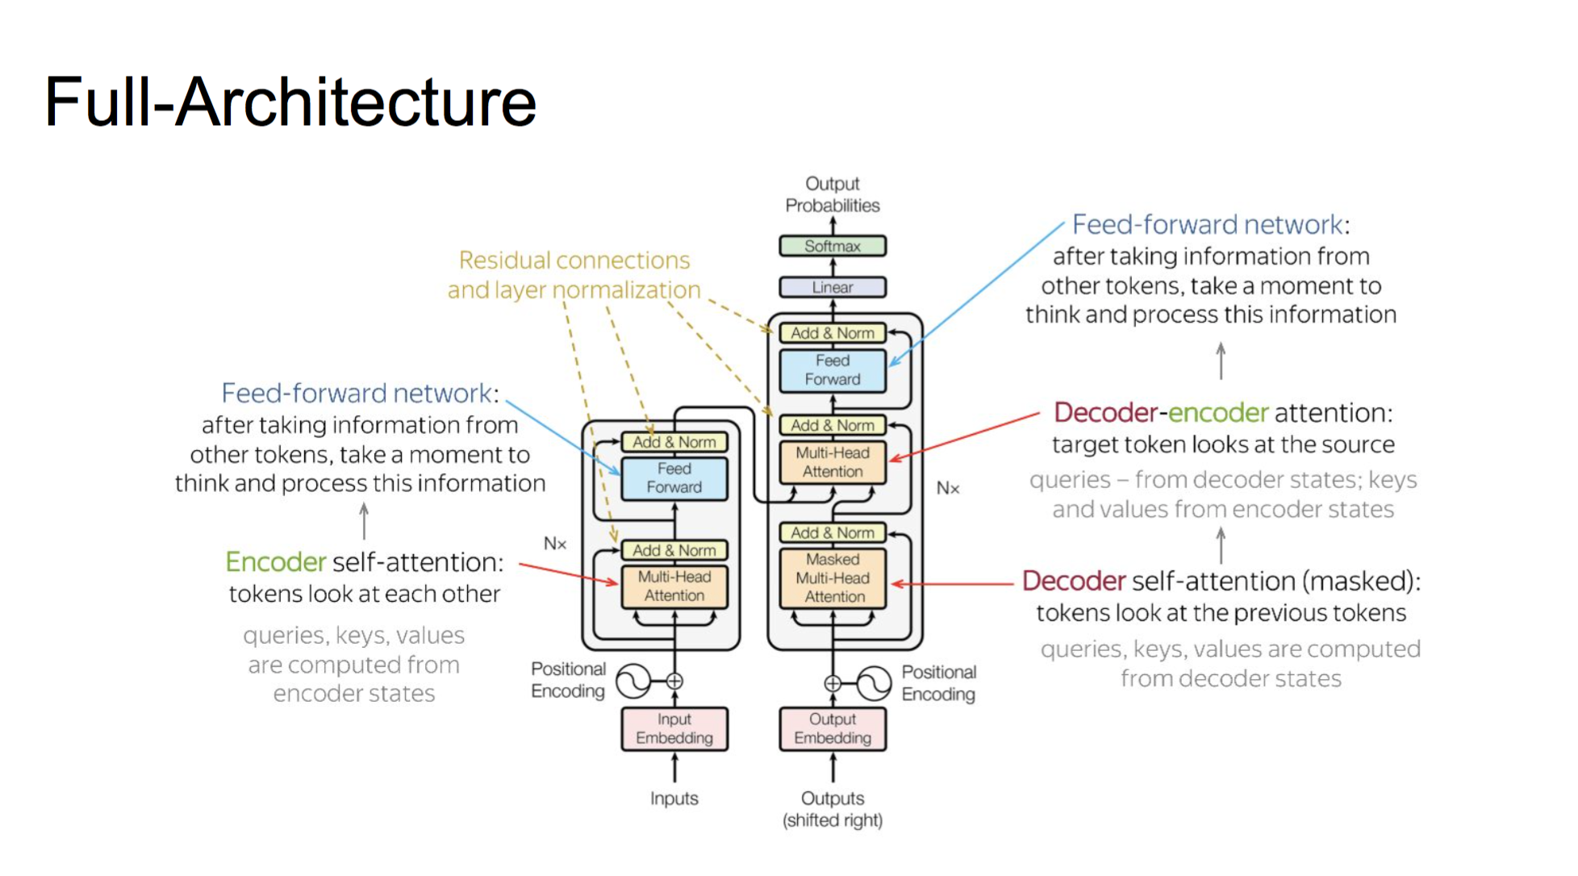
43
Notes:
Change low resource IL to a language which is not in wikipedia
Word-level: from bi-lingual dicts and alignment; structure-level comes from wals; multi-level alignment

Slide 44
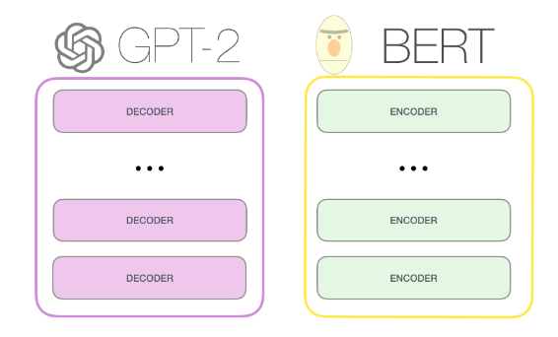
Relations Among Transformer model, BERT and GPT
A transformer uses an encoder stack to model input, and uses decoder stack to model output (using input information from encoder side)
If we do not have input, we just want to model the “next word”, we can get rid of the encoder side of a transformer and output “next word” one by one. This gives us GPT
If we are only interested in training a language model for the input for some other tasks, then we do not need the decoder of the transformer, that gives us BERT

Slide 45
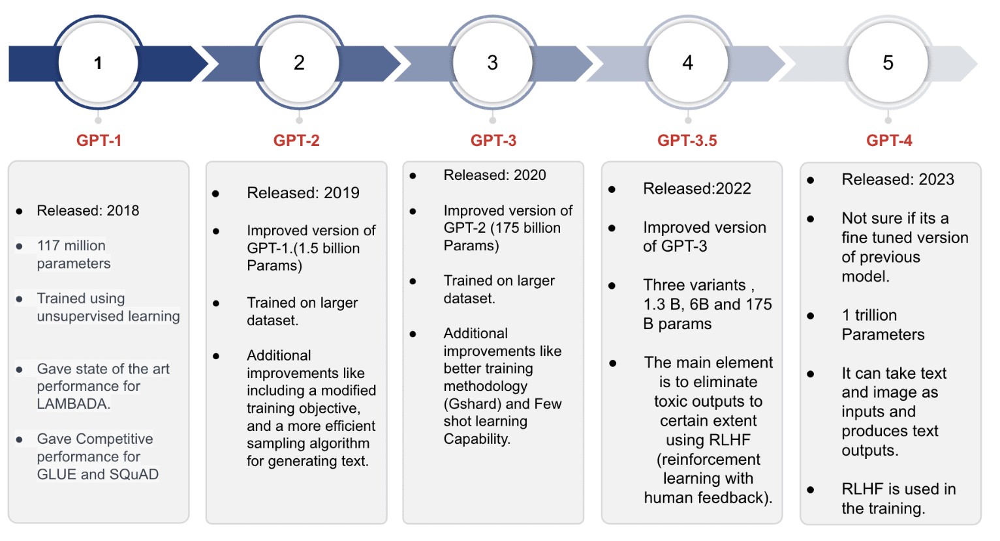
GPT4 Model
45
Notes:
Change low resource IL to a language which is not in wikipedia
Word-level: from bi-lingual dicts and alignment; structure-level comes from wals; multi-level alignment

